Slide 1
AMANAH’S PROFILE OF VALOR & VICTOR AMANAH’S ODYSSEY II : THE SUPREME ORDEAL CIRCA 2013-2017

Slide 2
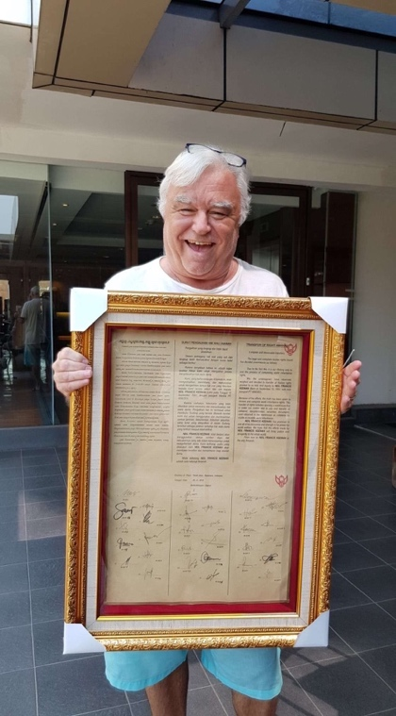
AMANAH NEIL KEENAN OF INDONESIA

Slide 3
AMANAH’S ODYSSEY II | THE SUPREME ORDEAL: NEIL KEENAN UPDATE 2013

Slide 4
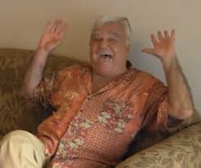
AMANAH’S ODYSSEY II | THE SUPREME ORDEAL: NEIL KEENAN UPDATE 2013
AMANAH’S PLAYLIST SONG May the Road Rise Up To Meet You - Irish Blessing Song

Slide 5
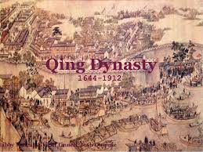
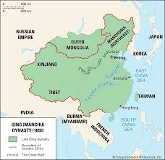
AMANAH’S ODYSSEY II|THE SUPREME ORDEAL: NEIL KEENAN UPDATE 2013
Keenan Meets with the Heads of the Qing Dynasty Clan
Chinese Empress, Bennie Hua

Slide 6
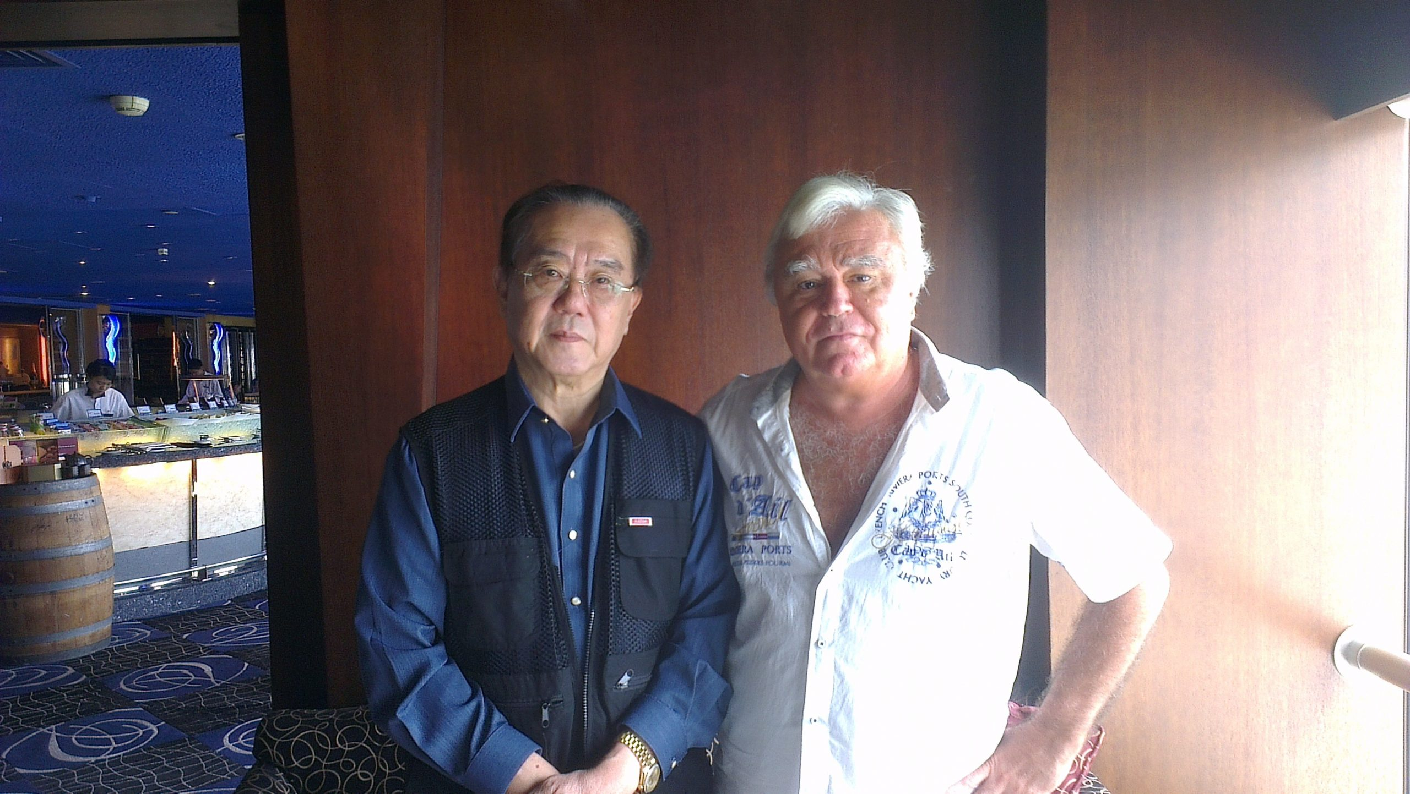
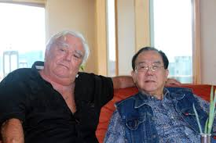
AMANAH’S ODYSSEY II|THE SUPREME ORDEAL: NEIL KEENAN UPDATE 2013
Count Albert S.C. Chiang of the Golden Dragon Family

Slide 7
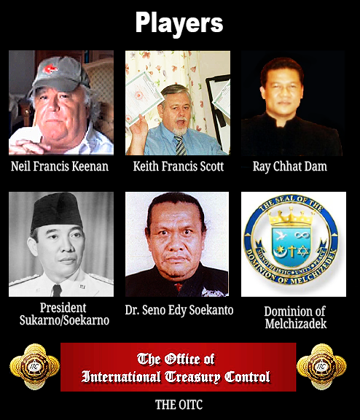
AMANAH’S ODYSSEY II|THE SUPREME ORDEAL: NEIL KEENAN UPDATE 2013
Keenan Deals with the OITC Players

Slide 8
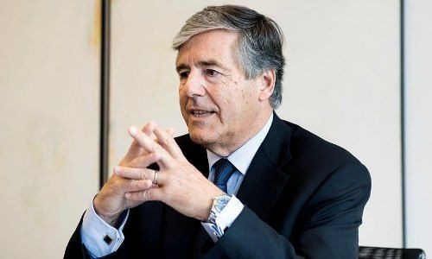
AMANAH’S ODYSSEY II|THE SUPREME ORDEAL: NEIL KEENAN UPDATE 2013
Josef Ackerman UBS-LLB GCA Theft To Establish a New Financial System

Slide 9
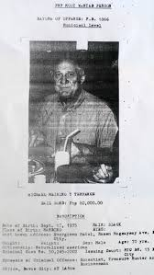
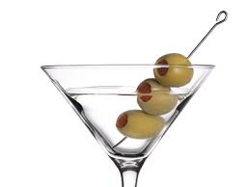
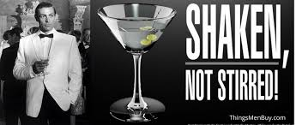
AMANAH’S ODYSSEY II|THE SUPREME ORDEAL: NEIL KEENAN UPDATE 2013
Dr. Michael Van De Meer aka Michael Meiring

Slide 10
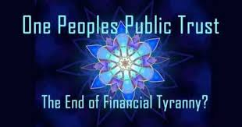
AMANAH’S ODYSSEY II|THE SUPREME ORDEAL: NEIL KEENAN UPDATE 2013
One Peoples Public Trust (OPPT) Principals: Paula Humphrey, Heather Ann Tucci-Jarraf, Brian Kelly, Lisa Harrison and Caleb Skinner
Malik Hughes
Madame Wu

Slide 11
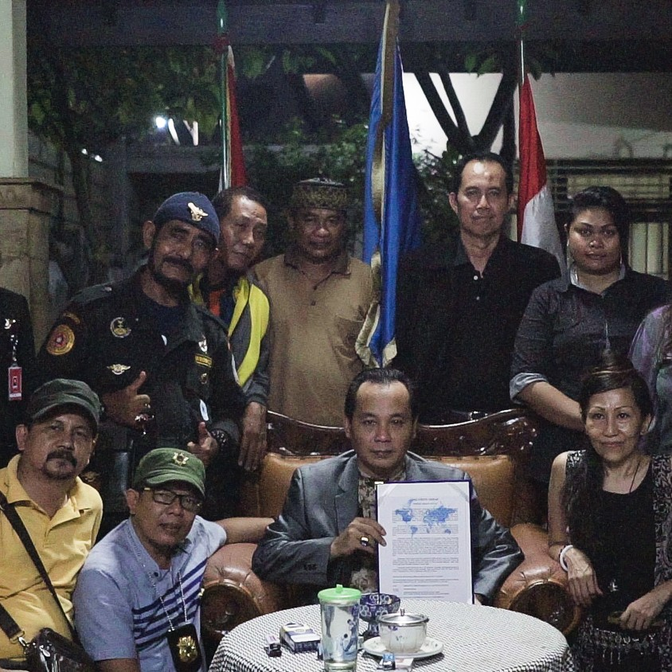
AMANAH’S ODYSSEY II|THE SUPREME ORDEAL: NEIL KEENAN UPDATE 2013
United Nations SwissIndo

Slide 12
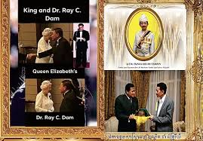
AMANAH’S ODYSSEY II|THE SUPREME ORDEAL: NEIL KEENAN UPDATE 2013
David P. Crayford’s (Crayfish) Whistleblower smear attempts of Neil Keenan to resuscitate the fraudulent Office of International Treasury Control (OITC)

Slide 13
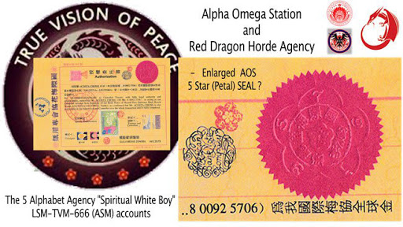
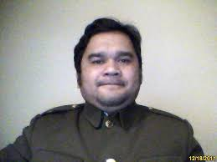
AMANAH’S ODYSSEY II|THE SUPREME ORDEAL: NEIL KEENAN UPDATE 2013
King Anthony Santiago Martin
AKA Spiritual White Boy

Slide 14
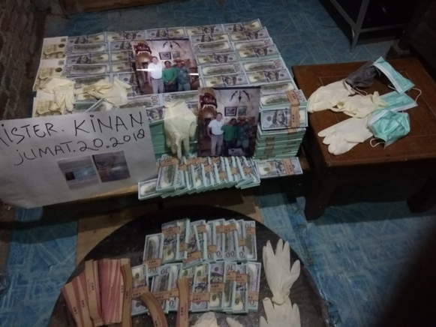
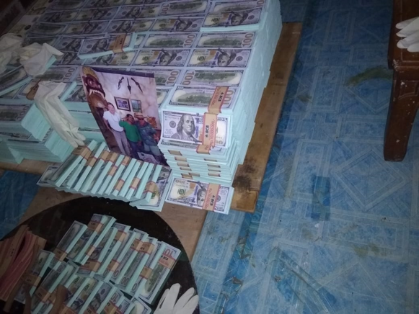
AMANAH’S ODYSSEY II|THE SUPREME ORDEAL: NEIL KEENAN UPDATE 2013
Global Collateral Account Keenan Funds

Slide 15
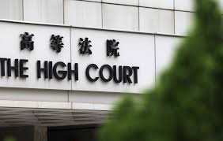
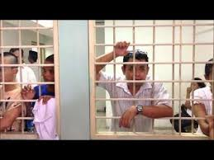
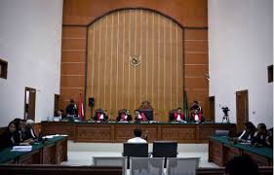
AMANAH’S ODYSSEY II|THE SUPREME ORDEAL: NEIL KEENAN UPDATE 2013
Keenan Works on the Freedom of Nelu (Wibawa)

Slide 16
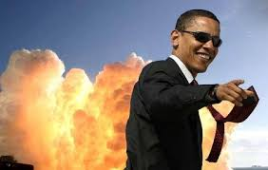
AMANAH’S ODYSSEY II|THE SUPREME ORDEAL: NEIL KEENAN UPDATE 2013
Obama’s 500 Attempted Gas Explosive Assassination on Group K Team Residing in Jakarta Hotel

Slide 17
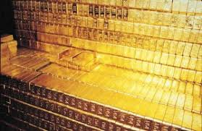
AMANAH’S ODYSSEY II|THE SUPREME ORDEAL: NEIL KEENAN UPDATE 2013
Attempted 300,000 MT Gold Caper by George Soros, the Emperor of Japan, the Rothschilds and South Korea

Slide 18
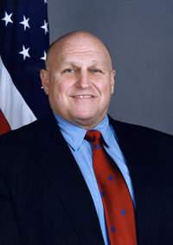
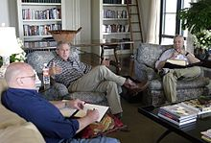
AMANAH’S ODYSSEY II|THE SUPREME ORDEAL: NEIL KEENAN UPDATE 2013
Richard Armitage, Deputy Secretary of State –A Member of the Bush Cartel

Slide 19
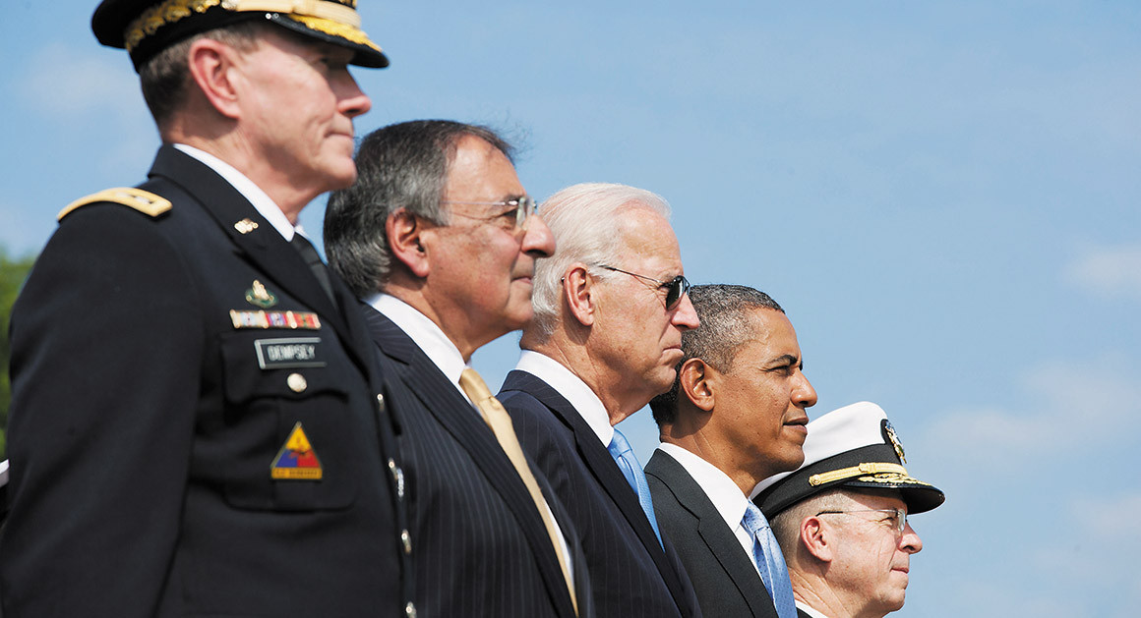
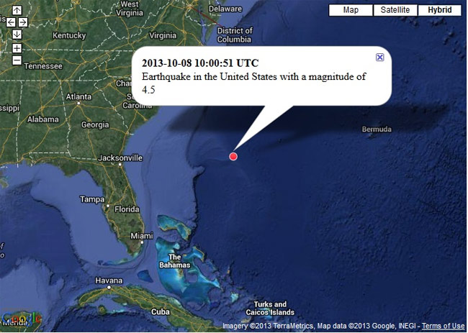
AMANAH’S ODYSSEY II|THE SUPREME ORDEAL: NEIL KEENAN UPDATE 2013
Intel Briefing: Pentagon Generals saved the eastern U.S. by exploding Nuclear War Heads off of Charleston, South Carolina causing an offshore Earthquake

Slide 20
AMANAH’S ODYSSEY II|THE SUPREME ORDEAL: NEIL KEENAN UPDATE 2013
Influential Count S.C. Chiang in Hong Kong opened channels for Neil Keenan within Asian Clans, Depositors Families and Indonesian royal asset-holders

Slide 21
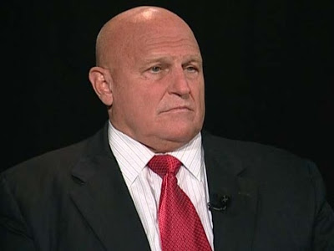
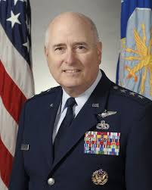
AMANAH’S ODYSSEY II|THE SUPREME ORDEAL: NEIL KEENAN UPDATE 2013
Bush family henchman Richard Armitage working with General Loren Reno in plundering planeloads full of gold from Indonesia destined for Hong Kong

Slide 22
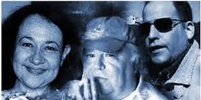
AMANAH’S ODYSSEY II|THE SUPREME ORDEAL: NEIL KEENAN UPDATE 2013
Karen Hudes former WB Lawyer Mis-Speaks and Benjamin Fulford Mis-Steps

Slide 23
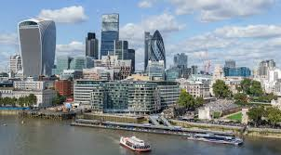
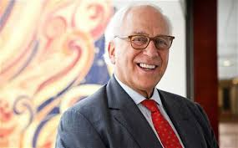
AMANAH’S ODYSSEY II|THE SUPREME ORDEAL: NEIL KEENAN UPDATE 2013
The City of London ‘Lions Den’— Sir Evelyn Robert Adrian de Rothschild 15 Trillion U.S. Dollar Offer and Neil Keenan’s refusal Catnip Counter Offer.

Slide 24
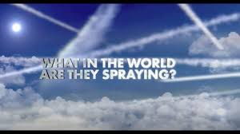
AMANAH’S ODYSSEY II|THE SUPREME ORDEAL: NEIL KEENAN UPDATE 2013
Neil Keenan Holds the Key to Stopping The NWO UN-WHO Agenda 21

Slide 25
AMANAH’S ODYSSEY II|THE SUPREME ORDEAL: NEIL KEENAN UPDATE 2013
The Dragon Family Depositors Global Collateral Accounts Asset Valuation

Slide 26
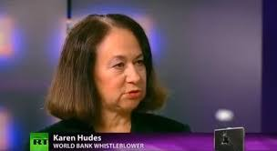
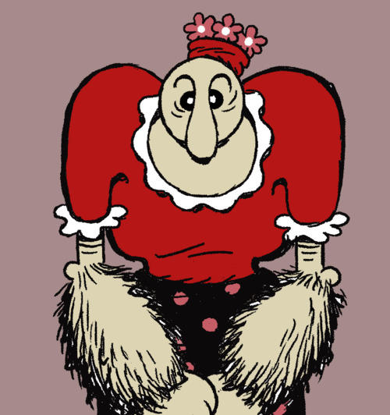
AMANAH’S ODYSSEY II|THE SUPREME ORDEAL: NEIL KEENAN UPDATE 2013
World Bank Disinformation Whistleblower Karen Hudes Attempts To Subvert Neil Keenan For Count Albert Chiang. She Receives Keenan’s Ultimate BITE!!!

Slide 27
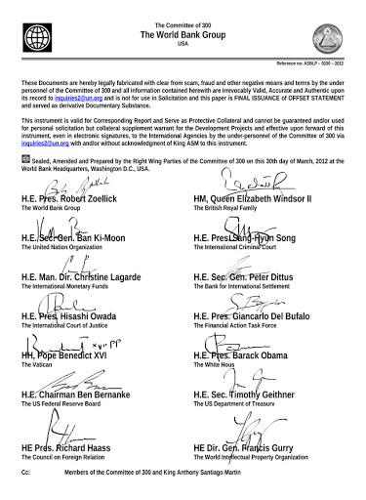
AMANAH’S ODYSSEY II|THE SUPREME ORDEAL: NEIL KEENAN UPDATE 2013
WORLD BANK-COMMITTEE OF 300

Slide 28
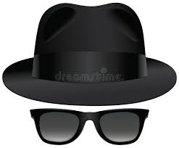
AMANAH’S ODYSSEY II|THE SUPREME ORDEAL: NEIL KEENAN UPDATE 2013
The Disguised Airport Escape From Jakarta to Europe
“Like watching a video game only with life and death stakes,” Neil.

Slide 29
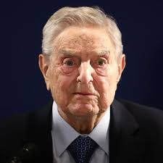
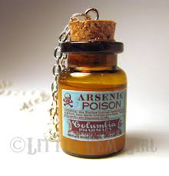
AMANAH’S ODYSSEY II|THE SUPREME ORDEAL: NEIL KEENAN UPDATE 2013
Cabal Poison Attempt: “We almost got Keenan,” George Soros

Slide 30
AMANAH’S ODYSSEY II|THE SUPREME ORDEAL: NEIL KEENAN UPDATE 2013
Cabal’s numerous attempted poisonings causing Neil Keenan’s serious health issues over years as noticed on right forearm

Slide 31
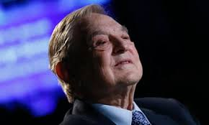
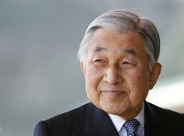
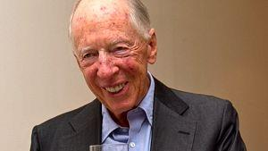
AMANAH’S ODYSSEY II|THE SUPREME ORDEAL: NEIL KEENAN UPDATE 2013
Keenan and Dragon Family Deters Cabal Soros, Rothschild. Biden and Emperor of Japan Ploys to Gold Grab from GCA Bunkers in Indonesia and South Korea

Slide 32
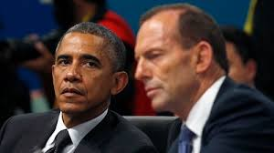
AMANAH’S ODYSSEY II|THE SUPREME ORDEAL: NEIL KEENAN UPDATE 2013
In the spirit of “Out with the Old and in with the New”, it is time to “settle up”- AND “Clean out the Clutter.”
You bad boys (Barrack Obama, Joe Biden and Tony Abbott) who want to steal the GOLD – we’re ready for you. Come try and get it!

Slide 33
AMANAH’S ODYSSEY II|THE SUPREME ORDEAL: NEIL KEENAN UPDATE 2014

Slide 34
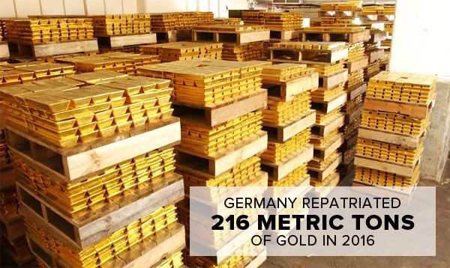
AMANAH’S ODYSSEY II|THE SUPREME ORDEAL: NEIL KEENAN UPDATE 2014
Germany stole over 17,000 tons of American gold in the 1930s, and now demands an additional 300 tons today.
Neil stands up to say, “Enough!”

Slide 35
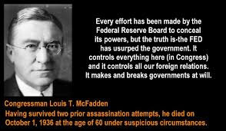
AMANAH’S ODYSSEY II|THE SUPREME ORDEAL: NEIL KEENAN UPDATE 2014
Neil Keenan Acknowledges Congressman McFadden’s Battles With the Powers of Federal Reserve Board, As Well As Relates To His Assassination Attempts

Slide 36
AMANAH’S ODYSSEY II|THE SUPREME ORDEAL: NEIL KEENAN UPDATE 2014
END THE FED

Slide 37
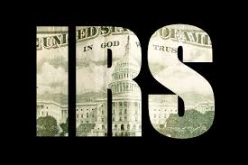
AMANAH’S ODYSSEY II|THE SUPREME ORDEAL: NEIL KEENAN UPDATE 2014
EXPOSES THE CORRUPT IRS: Philippine and Puerto Rico Trusts: 1953 The Bureau of Internal Revenue (BIR) Becomes Internal Revenue Service (IRS) by U.S. Treasury Order 150-06

Slide 38
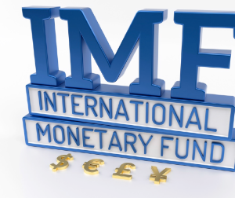
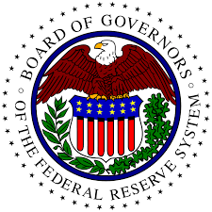
AMANAH’S ODYSSEY II|THE SUPREME ORDEAL: NEIL KEENAN UPDATE 2014
Neil Keenan Exposes the Cabal’s Corrupt Funneling of the International Monetary Fund With the Federal Reserve Giving Funds to International Banks.

Slide 39
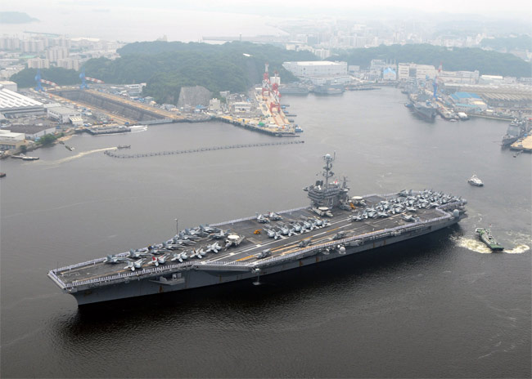
AMANAH’S ODYSSEY II|THE SUPREME ORDEAL: NEIL KEENAN UPDATE 2014
South Korean President Pak also known as the coordinator of the largest attempted Gold Heist in History (250 thousand metric tons) also belonging to the Golden Dragons was shut down in July 2014 by the Neil Keenan and his team.

Slide 40
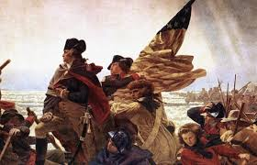
AMANAH’S ODYSSEY II|THE SUPREME ORDEAL: NEIL KEENAN UPDATE 2014
American Involvement in National and Global Wars
1776 American Revolution to 2021 Hybrid WWIV

Slide 41
AMANAH’S ODYSSEY II|THE SUPREME ORDEAL: NEIL KEENAN UPDATE 2014
President John F Kennedy “Secret Societies” Speech

Slide 42
AMANAH’S ODYSSEY II|THE SUPREME ORDEAL: NEIL KEENAN UPDATE 2014
Globalists New World Order GCA Assets ‘Fire Sale’
THE STATES ARE IN OPEN REVOLUTION AGAINST FEDERAL TYRANNY!

Slide 43
AMANAH’S ODYSSEY II|THE SUPREME ORDEAL: NEIL KEENAN UPDATE 2014

Slide 44
AMANAH’S ODYSSEY II|THE SUPREME ORDEAL: NEIL KEENAN UPDATE 2014
John Kerry’s Desperate Asian Antics and Ultimate Threat To Cause Indonesian Natural Disasters

Slide 45
AMANAH’S ODYSSEY II|THE SUPREME ORDEAL: NEIL KEENAN UPDATE 2014
Group K Sounds the Alarm of Cabal’s Agenda PLAN 1 | GMO POISIONING
“He who controls the food supply, controls the people.” Henry Kissinger.

Slide 46
AMANAH’S ODYSSEY II|THE SUPREME ORDEAL: NEIL KEENAN UPDATE 2014
PLAN 2 | GLOBAL WATER POISONING – U.S. EPA Clean Water Act

Slide 47
AMANAH’S ODYSSEY II|THE SUPREME ORDEAL: NEIL KEENAN UPDATE 2014
GLOBAL ACCOUNTS UNDER BY UN SWISSINDO SHENANIGANS AND SWINDLERS CAUGHT BY VATICAN POLICE WITH $3.1 TRILLION OF COUNTERFEIT BONDS.

Slide 48
AMANAH’S ODYSSEY II|THE SUPREME ORDEAL: NEIL KEENAN UPDATE 2014
THE OBAMA ADMINISTRAITON VERSUS THE BUNDY RANCH STAND OFF

Slide 49
AMANAH’S ODYSSEY II|THE SUPREME ORDEAL: NEIL KEENAN UPDATE 2014
GROUP K’S INTERNATIONAL CABAL NO FLY ZONE ACCORD AND QUID PRO QUO

Slide 50
AMANAH’S ODYSSEY II|THE SUPREME ORDEAL: NEIL KEENAN UPDATE 2014
Cabal Payback For Donetsk Referendum With Unarmed Urban Civilian Slaughter

Slide 51
AMANAH’S ODYSSEY II|THE SUPREME ORDEAL: NEIL KEENAN UPDATE 2014
Keenan Ends the 15 Quadrillion Dollar Vatican-Sultan of Sulu Deal That Would Have Sunk The Planet. “We are fighting the worst sons-of-bitches that ever existed on the face the planet.” Neil Keenan 5/19/14

Slide 52
AMANAH’S ODYSSEY II|THE SUPREME ORDEAL: NEIL KEENAN UPDATE 2014
Neil Keenan Urgent Intel of Secret Cabal Operation Disguised As Joint Naval Exercises in South Korea with the Japanese Navy Off the Coast of South Korea

Slide 53
AMANAH’S ODYSSEY II|THE SUPREME ORDEAL: NEIL KEENAN UPDATE 2014
Neil Keenan demands Bunker Guardian family members to Cease and Desist in attempting to market Global Accounts and/or the Soekarno Accounts Assets

Slide 54
AMANAH’S ODYSSEY II|THE SUPREME ORDEAL: NEIL KEENAN UPDATE 2014
Keenan reveals breaking high-level intelligence that the US government is about to hijack accounts at banks throughout the states.
Keenan exposes imposter Soegiharto Notonegoro, claiming to be the king of kings, and his backdoor attempt(s) to steal Dragon Family assets

Slide 55
AMANAH’S ODYSSEY II|THE SUPREME ORDEAL: NEIL KEENAN UPDATE 2014
Neil Keenan To Jean Haines and Her Jackals Steve Pollack and Paul Collins Enough is Enough.
Neil responds to Jean Haines' statement of disassociating herself from the Keenan Team. Illinois Attorney General Affidavits, Canadian RCMP Checkmate!

Slide 56
AMANAH’S ODYSSEY II|THE SUPREME ORDEAL: NEIL KEENAN UPDATE 2014
The phase one initiation was in preparation for what would happen next in December 2014 as Keenan journeyed back to Indonesia to experience an amazing opportunity to enter a ‘Depositors’ secretive Bunker.
Access to the ‘Depositors’ Bunker was not without multiple and unforeseen challenges. A number of clearances by the Elders were required before Neil and Jo could enter the bunker, but they remained undaunted by the long delays.
In a historic precedent of enormous consequence, Neil Keenan became the first Westerner to be invited by the Elders to enter a secretive ‘Bunker’— a vast repository of the ‘Depositors’ wealth comprised of: gold, jewels, museum artifacts, modern global currencies in all denominations, as well as, invaluable documents detailing the truth behind some of the atrocities committed against humanity. The historic documents will be used to fortify Neil’s lawsuit when it is re-filed.

Slide 57
AMANAH’S ODYSSEY II|THE SUPREME ORDEAL: NEIL KEENAN UPDATE 2014
As a token of appreciation for his extraordinary work, the Elders—per the Prince who oversees a warehouse of ‘Depositors’ assets—gave Neil Keenan a box containing gold bars. Neil shows the sealed box being pried opened with the gold bars inside.

Slide 58
AMANAH’S ODYSSEY II|THE SUPREME ORDEAL: NEIL KEENAN UPDATE 2014
This particular bunker—one of approximately 1,000 in Indonesia and throughout Asia—is a 16-acre, 4-level underground cavern filled with treasures accumulated for eons during the centuries of Spice Routes and Silk Roads and deposited by the Dragon Family over decades through the present years.

Slide 59
AMANAH’S ODYSSEY II|THE SUPREME ORDEAL: NEIL KEENAN UPDATE 2014
Neil Keenan’s Show and Tell of rare, genuine gold U.S. FRN Dollar Collection

Slide 60
AMANAH’S ODYSSEY II|THE SUPREME ORDEAL: NEIL KEENAN UPDATE 2014
With the assets from the bunkers, Neil’s intent was to provide gifts of friendship to all of those who have worked so diligently in supporting his efforts. But no, this did not happen. To this end, Neil did give $20,000 to the Guardian’s “runner” aka con-main Yulianto and his thieving associate Satrio.

Slide 61
AMANAH’S ODYSSEY II|THE SUPREME ORDEAL: NEIL KEENAN UPDATE 2014
The Clinton Gang has ridden in on their private jets, the Japanese Emperor’s sister has also flown in on her jet, and money transfers have taken place through Bill Clinton’s Arkansas Foundation. Funds are illegal, confiscated Colombian drug funds which somehow found their way from Clinton’s Foundation to Indonesia.

Slide 62
AMANAH’S ODYSSEY II|THE SUPREME ORDEAL: NEIL KEENAN UPDATE 2014
Keenan Shares Intel that the Wall Street Bankers Relocate Headquarters to Stamford Connecticut in Advance of a Pending False Flag NYC Event

Slide 63
AMANAH’S ODYSSEY II|THE SUPREME ORDEAL: NEIL KEENAN UPDATE 2014
South Korea is renewing President Obama, George Soros and Hillary Clinton’s efforts to take 240K metric tons of gold, and since the Dragon Family has surveillance on this, once again, they are implored to take action.

Slide 64
AMANAH’S ODYSSEY II|THE SUPREME ORDEAL: NEIL KEENAN UPDATE 2014
Group K reports on HAARP facilities revving up their Ionosphere activities, which is costly and not done without a very good reason. It has to end.

Slide 65
AMANAH’S ODYSSEY II|THE SUPREME ORDEAL: NEIL KEENAN UPDATE 2014
The Cabal operatives are the ones who have directed and concentrated recent weather events. Needless to say, the Cabal have the power and the wherewithal to save or destroy our planet and many a life.
This Weather Weaponry is one of the last tools they have left that remains functional and at their disposal. It is well understood by now that HAARP facilities can generate millions of watts of ELF (Extra Low Frequency) transmissions.
The Alaska and Clam Lake HAARP facilities transmissions are used to manipulate weather, including the spawning and directing of hurricanes; and the intensification of hurricane winds
Group K’s intention, once again, is to halt these nefarious activities by exposing them publicly.

Slide 66
AMANAH’S ODYSSEY II|THE SUPREME ORDEAL: NEIL KEENAN UPDATE 2017
Desperate Nations Still Have Dangerous Weapons….Don’t Be Fooled. Here Are Some of the Nefarious Criminals:
Jeongdaeseong – Korean resident living in Japan
Mori – Korean resident living in Japan
Nishida -Japanese
Hippo – Japanese
Kobayashi – Japanese
President Moon – Korea
Emperor Hirohito – Japan
Prime Minister Abe – Japan

Slide 67
AMANAH’S ODYSSEY II|THE SUPREME ORDEAL: NEIL KEENAN UPDATE 2014
Keenan shares Intel of Grande Lander is General Electric (GE)
Informs of an Emergency Alert issued by the FBI and DHS about an imminent terrorist attack and confirmed by local law enforcement on the NCIC DHS database system
Greater Southwest areas of the U.S.
El Paso, TX
Las Cruces, NM
Tucson, Phoenix and Yuma, AZ
San Diego and the greater Los Angeles area, CA

Slide 68
AMANAH’S ODYSSEY II | THE SUPREME ORDEAL: NEIL KEENAN UPDATE 2015

Slide 69
AMANAH’S ODYSSEY II | THE SUPREME ORDEAL: NEIL KEENAN UPDATE 2015
MODERN DAY PIED PIPER: THE RED DRAGON AMBASSADOR EXPOSED: BO MICHAEL LINDSTROM THE SON OF A SWEDISH AMBASSADOR

Slide 70
AMANAH’S ODYSSEY II | THE SUPREME ORDEAL: NEIL KEENAN UPDATE 2015
CORRUPT FINANCIAL ORGANIZATION SYMBOLS AND ITS CON-ARTISTS

Slide 71
AMANAH’S ODYSSEY II | THE SUPREME ORDEAL: NEIL KEENAN UPDATE 2015
COMMITTEE OF 300 WORLD BANK GROUP
“King” Anthony Santiago Martin (ASM)
The ASBLP Group of Companies
The Bank of ASBLP

Slide 72
AMANAH’S ODYSSEY II | THE SUPREME ORDEAL: NEIL KEENAN UPDATE 2015
Cabal ’appointed’ M1 Pres. Ferdinand Marcos willed the ASBLP Group and Bank of ASBLP to HM King Anthony Santiago Martin ” White Spiritual Boy”

Slide 73
AMANAH’S ODYSSEY II | THE SUPREME ORDEAL: NEIL KEENAN UPDATE 2015
HM KING ANTHONY SANTIGO MARTINA ‘WHITE SPIRITUAL BOY”

Slide 74
AMANAH’S ODYSSEY II | THE SUPREME ORDEAL: NEIL KEENAN UPDATE 2015

Slide 75
AMANAH’S ODYSSEY II | THE SUPREME ORDEAL: NEIL KEENAN UPDATE 2015
Bretton Woods Agreement is Null and Void. The West continues to illegally use the East’s deposits in the Global Accounts. The East will no longer tolerate it.
The hard assets are located in the East and have nothing to do with the World Bank or the IMF or BIS or any Central Banks. It is owned by the Depositors.

Slide 76
AMANAH’S ODYSSEY II | THE SUPREME ORDEAL: NEIL KEENAN UPDATE 2015
Worldwide Alert: Neil Is Pissed Off and Is Releasing His Weapons

Slide 77
AMANAH’S ODYSSEY II | THE SUPREME ORDEAL: NEIL KEENAN UPDATE 2015
U.S. A. Constitution 1st Amendment Section 10 has been violated for decades! The Federal Reserve Central Bank FRN corruption…Justice!

Slide 78
AMANAH’S ODYSSEY II | THE SUPREME ORDEAL: NEIL KEENAN UPDATE 2015
GERMAN JET CRASH: US/NATO jets were in the immediate vicinity of the jet prior to the crash.

Slide 79
AMANAH’S ODYSSEY II | THE SUPREME ORDEAL: NEIL KEENAN UPDATE 2015
The World Economic Forum (WEF) –Meeting in Indonesia WEF are the Bilderberg, Committee of 300, Club of Rome, Hidden Hand, etc.

Slide 80
AMANAH’S ODYSSEY II | THE SUPREME ORDEAL: NEIL KEENAN UPDATE 2015
Keenan encounters trouble in Jakarta: Meets Soros Mercenaries in the Jungle

Slide 81
AMANAH’S ODYSSEY II | THE SUPREME ORDEAL: NEIL KEENAN UPDATE 2015
THE VATICAN JESUIT POPE FRANCIS—PUBLICLY VERIFIES HIS ‘ALL AUTHORITY’ GLOBAL ROLE AS EXECUTIONER OF BILLIONS OF PEOPLE AND CHILDREN

Slide 82
AMANAH’S ODYSSEY II | THE SUPREME ORDEAL: NEIL KEENAN UPDATE 2015
KEENAN’S FIRST ROUND WITH MR. BIG STUFF –KNOCK OUT PUNCH!!!
The “Pope” is not a Pope he is a vicious Jesuit, or much worse – the Anti-Christ?

Slide 83
AMANAH’S ODYSSEY II | THE SUPREME ORDEAL: NEIL KEENAN UPDATE 2015
IT’S SHOWTIME! The Jesuits and Illuminati are making an attempt to steal back the financial system.

Slide 84
AMANAH’S ODYSSEY II | THE SUPREME ORDEAL: NEIL KEENAN UPDATE 2015
Will the 9/11 connection to the Global Collateral Accounts finally come to light? To these questions, Neil Keenan has a statement for the world:
“JFK, Soekarno, 9-11 and everything surrounding it all boils down to one and the same groups or organizations etc., that being what is known as the Cabal or NWO. Look no further than Rothschild’s, Rockefeller’s, and on a lesser scale Bush’s, Netanyahu’s …etc. Neil Keenan

Slide 85
AMANAH’S ODYSSEY II | THE SUPREME ORDEAL: NEIL KEENAN UPDATE 2015
Neil Keenan opted not to sign the Official Monetary 1 Mandate as Asian Insider I referenced as he intends to launch a separate Eastern Financial System

Slide 86
AMANAH’S ODYSSEY II | THE SUPREME ORDEAL: NEIL KEENAN UPDATE 2016

Slide 87
AMANAH’S ODYSSEY II | THE SUPREME ORDEAL: NEIL KEENAN UPDATE 2016
THESE ARE THE TIMES The Cabal will not be taking over Indonesia Indonesia is at the epicenter of everything that needs to transpire. It had to be. It has been at the center since the 1950’s when the Western Alliance and Japan moved their stolen assets throughout Asia to be used by them at a later date. And they did tuck it away for a rainy day and that day is now, and the place is Indonesia.

Slide 88
AMANAH’S ODYSSEY II | THE SUPREME ORDEAL: NEIL KEENAN UPDATE 2016
Everybody is fed up with the puppet Obama and the machinations of his handlers.
Neil states that without a President Trump, it would be extremely difficult to get assets from the Global Collateral Accounts into the United States without said resources being swiped by the cabal.

Slide 89
AMANAH’S ODYSSEY II | THE SUPREME ORDEAL: NEIL KEENAN UPDATE 2016
They Are All Watching You: ‘Malaysia’ $14 Trillion USD in a cash deposit in an offshore bank 1MDB
Ex- Malaysian Prime Minister Najib Razak convicted of seven charges in trial linked to multi-billion-dollar scandal also involving Bong Bong Marcos

Slide 90
AMANAH’S ODYSSEY II | THE SUPREME ORDEAL: NEIL KEENAN UPDATE 2016
“Lanny’ The Asian Insider was a Fly on the Wall, but no one can tell Neil Keenan what to say, do or decide.

Slide 91
AMANAH’S ODYSSEY II | THE SUPREME ORDEAL: NEIL KEENAN UPDATE 2016
Indonesian elected President Joko Widodo meets with Western Oligarchs

Slide 92
AMANAH’S ODYSSEY II | THE SUPREME ORDEAL: NEIL KEENAN UPDATE 2016
The current Indonesian and Netherlands contract for gold and uranium is locked into Freeport McMoRan until 2020. This contract as constructed is great for McMoRan, but not for the Indonesian people.

Slide 93
AMANAH’S ODYSSEY II | THE SUPREME ORDEAL: NEIL KEENAN UPDATE 2016
The IMF, BIS, WORLD BANK and Indonesia Executive Branches are now placed on notice by Neil Keenan that the Global Collateral Account Assets are owned by the Depositors, not the Elders who are guarding the Bunkers.

Slide 94
AMANAH’S ODYSSEY II | THE SUPREME ORDEAL: NEIL KEENAN UPDATE 2016
Neil Keenan Is Recovered and He’s Back Neil is angry that many capable individuals have let you people down by not stepping up at critical times. Despite this, Neil has vowed to continue fighting until the very end, because he deeply cares about you people!

Slide 95
AMANAH’S ODYSSEY II | THE SUPREME ORDEAL: NEIL KEENAN UPDATE 2016
We don’t want to change the world. We want to fix it.
Neil called the shot that the NATO / US / Finns were secretively running around about the Russian border, while he also pointed out the possibility that Obama was looking to create WW3 once again.
Remember, Obama is the NWO puppet
Obama Calling For German Military Support To Fight Russia

Slide 96
AMANAH’S ODYSSEY II | THE SUPREME ORDEAL: NEIL KEENAN UPDATE 2016
The Western Banking System Partners BIS, IMF, World Bank, and Federal Reserve Central Banks are applying pressure to the Eastern governments to turn over all their assets to them in an attempt to replenish their war chest while getting ready for what ultimately could be a major war .
What they were doing and are again now doing is melting the gold bars down into ingots. They are changing the stamps and seals, and of course, all the paperwork hoping this is enough to get things free. The refinery is busy once again the same as 2014, and they are working hard at getting things ready.

Slide 97
AMANAH’S ODYSSEY II | THE SUPREME ORDEAL: NEIL KEENAN UPDATE 2016
M2, a brilliant strategist states, “There is going to be a huge Greek bailout involving a very large bank, but guess what? Greece will not get the money!” Yanis, the ex-Greek Finance Minister calls it “Economic Waterboarding”. Guess who will get the money? Germany and France!

Slide 98
AMANAH’S ODYSSEY II | THE SUPREME ORDEAL: NEIL KEENAN UPDATE 2016
My M2 advised me that there is so much money, not just for Europe, but for the entire world! If so, why are we fighting? The answer is simple: The Globalists insist they control the world, and they cannot do it with so many of us awakening! Depopulation is necessary for them to maintain control. This is not going to happen without a fight!

Slide 99
AMANAH’S ODYSSEY II | THE SUPREME ORDEAL: NEIL KEENAN UPDATE 2016
Initially, the necessary funds already in my bank account were stolen. Then last week when new money transfers to compensate were being sent to me, the US banks would not allow it to slide through the system so they intentionally blocked the transfers and returned them to sender. So, I am at it again seeking another route to avoid more of same. Do not worry. I have someone kicking me in the ass, and it is enough to keep me going.

Slide 100
AMANAH’S ODYSSEY II | THE SUPREME ORDEAL: NEIL KEENAN UPDATE 2016
Message to Neil Keenan from the Dragon Family: “Let the history books say WWW III ended on April 30, 20016.”
Executive Order -- Facilitation of a Presidential Transition –
General Dunford Joint Chief of Staff- Charge of Military Transition of Power

Slide 101
AMANAH’S ODYSSEY II | THE SUPREME ORDEAL: NEIL KEENAN UPDATE 2016
Obama starts by saying, “It is my honor to be at my last, and perhaps the last, White House Correspondent’s Dinner”, and he next says, “The END of the Republic never looked better!” “I am just counting the days before my death panel!” Then in the final act, he said, "I have only 2 words to close with… Obama… Out!” (Obama raises two fingers to his lips and Drops Mic)

Slide 102
AMANAH’S ODYSSEY II | THE SUPREME ORDEAL: NEIL KEENAN UPDATE 2016
Citibank was forced to default to AIB / WF / HSBC with a 10:00PM deadline on Citibank to get Basil III compliant or default. This was signed in a backroom deal at 8:59:59 PM on May 1, 2016, which brought it back into compliance.”
Security Forces which earlier had been pulled from holding back the Citibank redemption locations were returned by midnight as 800#s and sovereign rates authorized for the Sunday, May 1st release.

Slide 103
AMANAH’S ODYSSEY II | THE SUPREME ORDEAL: NEIL KEENAN UPDATE 2016
China officially announced that the historical bonds will be redeemed. Madame Wu exchanged signatures with representatives of the Fed in Atlanta and has kicked off Tier 5. The Dinar and Zim has gone gold-backed.
There were 4 fake Madame Wu’s a few years ago (all appointed by the CIA).

Slide 104
AMANAH’S ODYSSEY II | THE SUPREME ORDEAL: NEIL KEENAN UPDATE 2016
South Korea is the melting pot for holding WWII gold. South Korea has more than 3,000,000 mt of gold, which is being planned via transaction between President Park and Globalist Organizations from throughout the world.

Slide 105
AMANAH’S ODYSSEY II | THE SUPREME ORDEAL: NEIL KEENAN UPDATE 2016
Neil Keenan parts ways with Drake Bailey and Tommy Williams of Cosmic Voice
“Drake was wonderful and a close friend, but sometimes good things come to an end and such is the case.”

Slide 106
AMANAH’S ODYSSEY II | THE SUPREME ORDEAL: NEIL KEENAN UPDATE 2016
Kim Goguen (aka Kristie Adams) broke off from Cosmic Voice to set up her fraudulent Manna World Trust.

Slide 107
AMANAH’S ODYSSEY II | THE SUPREME ORDEAL: NEIL KEENAN UPDATE 2016
The de Jure Republic of the united States
The offices and officer positions have not been filled, nor can they be filled, with the existing Congressmen (or women), Senators, Judges, President or other Corporate government officials duly elected or appointed; as all existing usurpers have committed fraud and a host of other unconstitutional acts.

Slide 108
AMANAH’S ODYSSEY II | THE SUPREME ORDEAL: NEIL KEENAN UPDATE 2016
AN AUDIT AND RESPONSE BY ANONYMOUS
We are also aware that in order for Neil Keenan to verify and expose the above (Obama Transition of Power), he chose to let go of billions in profit in a deal with the US Treasury regarding the purchase of 300,000 MT of AU.
This was to be a deal with the New Republic, not the old Zionist Cabal one, which is the only way, according to the documents we have seen, that Mr. Keenan would deal with them. The Cabal and the Bush/Clinton families had to be gone in order for this business transaction to be completed.
Throughout our extensive research we are very much aware of Mr. Keenan using $US9.5 million (not including frozen/stolen accounts totaling more than $US185 million) of his own money to finance his many global efforts.

Slide 109
AMANAH’S ODYSSEY II | THE SUPREME ORDEAL: NEIL KEENAN UPDATE 2016
The Global Collateral Accounts are the Real Deal….No More GESARA NESARA Disinformation Blah…Blah…Blah….It’s A Cabal Con Job Game. Who would benefits from a debt jubilee or a wealth distribution?
if you write off debt and give every man, women and child a million dollars you will see products will cost a lot more as inflation will skyrocket. But will it hurt the ‘elite’? Not really.
Solution: Restore the De Jure Republic of the united States of America Continental Congress

Slide 110
AMANAH’S ODYSSEY II | THE SUPREME ORDEAL: NEIL KEENAN UPDATE 2016
Fake issues of $100 Federal Reserve Notes printed and warehoused in China. Taiwan has crates full too. The Philippines have crates of un-cut sheets
And Neil has bunkers full in Indonesia of all kinds of rotting paper.
Yes, the foundation of the described transaction is fraudulent. Period.
UBS cannot use Collateral Account gold or assets as collateral backing such issuances of currency regardless of who or where the currency is printed.

Slide 111
AMANAH’S ODYSSEY II | THE SUPREME ORDEAL: NEIL KEENAN UPDATE 2016
SG UNITED NATIONS BUSTED: Secretary General of the UN Ban Ki moon unofficially visited South Korean President Park being there was an attempt to keep the NWO or Globalist Agenda alive.
Empty handed, Ban Ki-moon then traveled to China to meet President Xi Jinping. Xi had him wait and sat amused by the UN offerings. After all, for nearly 75 years China and Asia have had to take a back seat to this totally corrupt organization entitled the United Nations.
The Dragon Family was offended and amused by the nerve of this Moonie. The Chinese sat there smiling saying to themselves “What do you want this time, you old thief?”

Slide 112
AMANAH’S ODYSSEY II | THE SUPREME ORDEAL: NEIL KEENAN UPDATE 2016
Why President Park ‘had to go’ had to do with her not delivering the Gold to Jeb Bush and the US Treasury—again Neil Keenan and team had stopped it.
Park could not and did not relent after many times being requested to do so. She stood strong as a Korean should supporting her people.
She wanted Korea’s national and international debt paid and more than anything she wished for and wanted the reunification of Korea. As they all do.
She has united and joined forces with many known and unknown for this very reason unbeknownst to the Western World (Globalists).

Slide 113
AMANAH’S ODYSSEY II | THE SUPREME ORDEAL: NEIL KEENAN UPDATE 2016
Rebuked Ban Ki-moon made desperate calls to Japan advising them that he is being rebuked throughout Asia and needs large amounts of money. Little did he know that Japan would be doing the same. He then asked them for money.
Others also called the Japanese Emperor (Rockefeller) and Japanese Prime Minister demanding cooperation ‘or else’. Tremendous pressure was applied to the Japanese, so much so that the Emperor stated on July 13, 2016 that he is going to retire. Kathmandu Post: Japanese Emperor Akihito ‘plans to abdicate’

Slide 114
AMANAH’S ODYSSEY II | THE SUPREME ORDEAL: NEIL KEENAN UPDATE 2016
The Exclusive Meeting of Three Agenda: End the FIATs of the Western Bankers; there were to be no World Bank, IMF or BIS
Neil recently took a business trip when invited to attend an important meeting. The requirement was so urgent that the initiators of the meeting sent their own private jet. Under heavy security Neil and M2 met with one of the leading figures at the very top of the Globalist / NWO movement.
The key Agenda was the establishment of a totally separate Eastern Gold Asset Based Financial System.
The mutual understanding was that Neil will have access to (not ownership of) between 400,000 and 600,000 metric tons of Gold to create the foundations for a solid world financial system that will keep us all alive and well, and it will replace the former NWO / Globalist / Cabal system.

Slide 115
AMANAH’S ODYSSEY II | THE SUPREME ORDEAL: NEIL KEENAN UPDATE 2016
Another matter that emerged during this meeting detailed something far more diabolical, as Neil and M2 were given a two month warning about a plot that involves the UN and the Obama Administration’s plans for the United States to eliminate 80% of the population through starvation and civil unrest.
It is Obama’s plan to create another false flag; but this time on a massive, unprecedented scale. The plan would see the blame laid upon “foreign terrorists” for an EMP (Electronic Magnetic Pulse) attack on the electricity grid of North America.

Slide 116
AMANAH’S ODYSSEY II | THE SUPREME ORDEAL: NEIL KEENAN UPDATE 2016
The Bio-Resonance Therapy Healing Computer
Despite being poisoned more than 7 times in order to keep him from this heroic quest, as well as having significant funds abruptly stolen from his accounts on two occasions, Neil moved forthrightly to another major vehicle by which to take the bastards down.
That being the life-enhancing and life-saving new technologies brought directly to the people while bypassing the corrupt “Big Pharma” and so-called “modern medicine” that leave many people dying / dead / bankrupt – just as the central banking system does with their crooked debt schemes.
So, this is where the other side of Neil’s brain kicked in to go after the Cabal – smack dab into the medical and pharmaceutical worlds – two big Cabal money makers that never had any business dictating our business and who took away our health and our sovereignty.

Slide 117
AMANAH’S ODYSSEY II | THE SUPREME ORDEAL: NEIL KEENAN UPDATE 2016
Group K’s Disruptive Innovations:
The immediate need is to get more ‘Healing Computers’ out there into the world. The waiting lines are currently way too long, and so many deserving people are in immediate need for healing intervention.
Free Energy devices will produce 30 kilowatts per hour, and further information will be released shortly.
Water Treatment Technology is also nearly ready to be released. This fantastic technology will clean up our oceans and straighten out the horrific mess the Cabal made with Fukushima. Our oceans will ultimately be returned to us… whether they like it or not!
Satellite Systems

Slide 118
AMANAH’S ODYSSEY II | THE SUPREME ORDEAL: NEIL KEENAN UPDATE 2016
Keenan receives intel, investigates audits, requests UN arrests warrants and seeks justice of the former Sri Lankan President, Mahinda Rajapaksa, the former Japanese President Shinzo Abe and Japanese Gold buyers in the four year old theft of 20 thousand metric tons of gold.

Slide 119
AMANAH’S ODYSSEY II | THE SUPREME ORDEAL: NEIL KEENAN UPDATE 2016
United Nations invites Neil Keenan to attend a meeting to discuss financing, new technologies, and the Global Collateral Accounts. The UN is awaiting Neil’s decision as to whether he will accept the invitation or not.
Neil opted not to attend as he does not acknowledge the UN as being either a legal nor a lawful organization; rather it is just another cabal-run corporation. He believes the East will set things up better in a much more solid and robust manner for the people of our planet.
Neil states that the only circumstances under which he would accept such an invitation, would be because the UN had accepted his demands for the majority of seats on the particular UN committee; thereby establishing Neil’s credence that the Golden Rule applies: “He who has the gold makes the rules”.

Slide 120
AMANAH’S ODYSSEY II | THE SUPREME ORDEAL: NEIL KEENAN UPDATE 2016
1 Million Metric Tons of gold has been sold by the King of Thailand. How or why he would sell something that does not really belong to him warrants immediate auditing.
The Dragon Family should dispatch Sister to said location and / or acquire the AU registration numbers and research just how much of that gold belongs to the Family itself.
President Park of South Korea has ordered the military to take over a bunker that she does not own. It is time for the Dragon Family to come forth immediately and stand fast in recovering and taking over their own assets.
The Elders have been watching over many bunkers throughout Asia for a long while without being compensated one cent for their long, hard, and dangerous work.

Slide 121
AMANAH’S ODYSSEY II | THE SUPREME ORDEAL: NEIL KEENAN UPDATE 2016
THE CABAL’S PLOT TO CASH-IN ON THE REVALUATION OF CURRENCIS BUSTED BY KEENAN AND THE DRAGON FAMILY
The Golden Dragon Family caught these criminals out long before they had the opportunity to action this; by checking and confirming the registration numbers of all dollars and dinars – only to identify the dollars as being Fake dollars-worth nothing in terms of real metal (Au).
These Cabal operatives may now consider themselves busted given that the Dragons have henceforth excluded them from participating any further in the redemption. Furthermore, the Dragon Family have now replaced all Iraqi Central Bankers with notable and honorable ones

Slide 122
AMANAH’S ODYSSEY II | THE SUPREME ORDEAL: NEIL KEENAN UPDATE 2016
I am sorry to learn that Ben Fulford says I am dead. I just checked myself, and everything seems to be in place; I went to the toilet and everything worked just fine.
Recently, the Clintons did seriously threaten us. As a result, I did contact one of their hit men here in Europe and was told that Ben was going first and then myself.
There were a couple of attempts in the past couple of months to eliminate me, and in both instances, I dealt with things pretty well.
First my toe was severely damaged about 2 months ago and then my leg was nearly broken. It seemed as though everything was getting torn up.
Finally, the poison packs started opening in my body, which tore me up during the past two weeks or so. Now Benjamin says that I’m dead. Well, if I’m dead, I’m doing a great job of looking alive!

Slide 123
AMANAH’S ODYSSEY II | THE SUPREME ORDEAL: NEIL KEENAN UPDATE 2016
Malaysian Prime Minister Najib Razak finds himself in the limelight once again along with everybody’s best friend Alfredo Sauren, the Thai [Corporate] Government, the US Federal Reserve [Corporate] Chairperson Janet Yellen and also the Bank of England
The 1 Million MT of Gold deal seems to have come together and Najib Razak and Sauren have already flown off to meet with Janet Yellen to sell the Golden Dragon Family’s gold for new US FIAT currency. Busted!

Slide 124
AMANAH’S ODYSSEY II | THE SUPREME ORDEAL: NEIL KEENAN UPDATE 2016
These Cabalists are all in this to enrich themselves, to steal assets belonging to the Depositors (The Golden Dragon Family), and to split up approximately 3 Trillion USD in payouts…Let me share with you the numbers:
Gold USD: 50,000 Kg x 1,000,000,000 Kgs = USD 50,000 000,000,000 (Trillion)
Gold Certificates made by Alfredo Saurin in Hong Kong x 20 = USD 1,000,000,000,000,000 (1 Quadrillion USD)
In USD Federal Collateralized New Fiat Issues – 20+x=20 Quadrillion USD or more as FED notes are collateralized globally x 20 again.
Everyone gets a Billion Dollar or a Trillion Dollar Commission! And get this: Not one bar is owned by those selling them!

Slide 125
AMANAH’S ODYSSEY II | THE SUPREME ORDEAL: NEIL KEENAN UPDATE 2016
Neil Keenan and team have put that which is required on the table in order to warrant an investigation into the many major bankers involved in the “One Million Metric Tons of Gold Deal”.
Mark Carney, the Governor of the Bank of England (BoE owned by the Rothschilds), who was involved in the I Million MT Gold Deal is resigning.
The Bank Boss Mr. Carney is looking for a way out as he must be well aware of an imminent investigation. Most here in England who are “in the know”, are taking measures to separate themselves from the syndicate.

Slide 126
AMANAH’S ODYSSEY II | THE SUPREME ORDEAL: NEIL KEENAN UPDATE 2016
Keenan has the names of the Banks, Cabal crooks and their underlings who are planning on selling out the Family’s assets amounting to Trillions and/or Quadrillions of Dollars-worth of stolen Assets. Neither the sellers and deal brokers in these illegal transactions own none of the asset transactions.
Not one party involved in these deals is legally entitled to be doing the gold assets and certificates transactions. The assets were intended to be used for humanitarian purposes for the people of the planet and most especially Indonesia and not for the pockets of the Cabal and their minions.
With so much fiat money being tossed around for Gold you must congratulate President Duterte of the Philippines for tossing out the Globalists and looking for sovereignty for the Island.

Slide 127
AMANAH’S ODYSSEY II | THE SUPREME ORDEAL: NEIL KEENAN UPDATE 2016
“…If the American people ever find out what we have done, they would chase us down the street and lynch us.” – George Herbert Walker Bush, 1992 Well George, the people have awakened and the time has come for you.
The War Mongers, Khazarian Zionists, Nazis and others will finally be imprisoned where they belong. The Bush’s and Clinton’s among others will be long tucked away where we will never see them again.

Slide 128
AMANAH’S ODYSSEY II | THE SUPREME ORDEAL: NEIL KEENAN UPDATE 2016
Donald J. Trump elected 45th President of the United States
The Republic of America is in good hands now and once it starts rolling, the Democratic Party should be kicked right out of our political scene (Obama and his Shadow Government did attempt a coup which is Treasonous).
There are many organizations and individuals that should be tossed out of America including many of the major media outlets.

Slide 129
AMANAH’S ODYSSEY II | THE SUPREME ORDEAL: NEIL KEENAN UPDATE 2016
It is ‘We the People’ vs. The corrupt, perverted, demented establishment.
Neil Keenan, and Group K have prevented from conclusion, a highly unlawful and damaging scam set to keep the crooked Cabal alive (via the 1 Million Metric Tons of Gold deal) creating dangerous setbacks for the world economy.
The 1 Million Metric Tons deal ties directly into the current US “silent coup” and how the ill-gotten gold buttresses the financial fortunes of the elite ‘establishment’ to keep their position and maintaining – as well as expanding – their control of the world’s financial power base.
The US election is nothing more than a façade or distraction to what they really are fighting for i.e. to maintain a stranglehold on the electorate… CONTROL! On November 15, it is alleged that the involved parties will meet to split up the “spoils” of this unlawful gold transaction in the Malaysian Bank Negara or in the HSBC in Kuala Lumpur.

Slide 130
AMANAH’S ODYSSEY II | THE SUPREME ORDEAL: NEIL KEENAN UPDATE 2016
Neil Keenan and Group K recommended immediate actions:
1. Cessation of Chemtrail Spraying and Geo-Engineering Weather Warfare
2. Cessation of HAARP Activities and Space Satellite Warfare
3. Curtailing of GMO / Agri-Chemical Industry Weaponized Foods
4. Exposing and Halting of United Nations Agenda 21 / Agenda 30
5. Put the Pharmaceutical Industry on Notice and End Vaccinations
6. Stop the Privatization of Public Water Supplies
7. Stop the North Dakota Pipeline
8. Stop and Re-Institute the “One Million Metric Ton Gold Deal” Transaction Directly with the US Treasury

Slide 131
AMANAH’S ODYSSEY II | THE SUPREME ORDEAL: NEIL KEENAN UPDATE 2016
Neil Keenan and Group Key Achievements to Date:
The Trillion Dollar Law Suit October 2011
Keenan Files Liens Against G7 Central Banks and 12 Fed Banks May 2012
Keenan’s Intelligence Stops Nuclear Warheads Charleston, S. C. Oct. 2013
Keenan Dispatches “Cease and Desist” to U.S.A. Corporation Feb. 2014
Keenan Exposes the IRS as a Foreign Entity February 2014
Keenan Puts Forth His Proposal for the “No Fly Accords” April 2014
Keenan Halts 15 Quadrillion Dollar Deal Between Sultan of Sulu, P2 Lodge and Vatican July 2014
Keenan Exposes Plot for Japan to Invade Indonesia To Steal Gold Aug. 2014

Slide 132
AMANAH’S ODYSSEY II | THE SUPREME ORDEAL: NEIL KEENAN UPDATE 2016
Keenan Shares Intelligence that “Wall Street” was Moving out of New York City to Stamford Connecticut August 2014
Keenan Exposes the Planned World Economic Forum (WEF) Being Held in Jakarta April 2015
Neil Keenan Elected M1 Monetary Controller of The Global Collateral Accounts December 2015 [Opted to not officially signed M1 document]
Philippine President “Bongbong” Marcos’ Involves Malaysian President Najib Razak into a $14 Trillion USD Cabal Re-Financing Deal February 2016
Keenan Exposes Cabal Plot to Replace the “Old” US Republic With “New Republic” as a New Label on the Same System May 2016

Slide 133
AMANAH’S ODYSSEY II | THE SUPREME ORDEAL: NEIL KEENAN UPDATE 2016
Keenan Exposes an Attempted Cabal Re-Financing Plot Using Ban Ki-moon, Jeb Bush et al. President of China Xi Jinping and President Park of South Korea Alerted. Plot Averted July 2016
Keenan Exposes Financial Doomsday Plan to EMP North America to Cancel Elections and More August 2016
The United Nations Invites Neil Keenan to Discuss Financing, New Technologies & The Global Collateral Accounts September 2016
Keenan Exposes The Connection Between 9/11, JFK and the Global Collateral Accounts
The Fed Fraud: The European- Controlled Creature That’s Bled Us for 100 Years

Slide 134
AMANAH’S ODYSSEY II | THE SUPREME ORDEAL: NEIL KEENAN UPDATE 2016
Former Queen Beatrix of the Netherlands is on the Trail Attempting Thievery Once Again. Beatrix is a representative of the family that created the Bilderberg Group – the biggest group of thieves on the planet
After she screwed up a perfectly good financial $2.3 Trillion transaction in 2012, one that would have benefited not only the Dutch Royal Family, but the people of The Netherlands as well.
Both Former Queen Beatrix and Queen Elizabeth dueling bloodlines are now attempting to deceive President Jokowi and the Nation of Indonesia of the $2.3 Trillion CD – with what Beatrix circus clowns call a “Debt Repayment”.
Both Royal sons, Willem-Alexander and Charles attempted to negotiate the rights to the CD, but returned from Indonesia empty handed.
The Dutch Royal Family was to earn 3% of said value (2.13 Trillion USD) and the Dutch nation, 2%.”

Slide 135
AMANAH’S ODYSSEY II | THE SUPREME ORDEAL: NEIL KEENAN UPDATE 2016
These ‘Royal’ families have no right to anything! Nor do the Holders own the Certificate of Deposit. Only the Depositors own the Certificate of Deposit.
Should any metals or paper assets leave Indonesia – or anywhere – they will find us waiting for them. We have stopped them time and time again.
We will stop them right up until the end as well, and open up the accounts for Humanitarian Packages
As for Donald Trump looking to make a Gold Backed Dollar – he already knows that I can bring forth the AU not only for such a thing, but much more, larger than any number heard to date – but for the rebuilding of our entire infrastructure – and it does not even evolve from the Global Collateral Accounts.

Slide 136
AMANAH’S ODYSSEY II | THE SUPREME ORDEAL: NEIL KEENAN UPDATE 2017

Slide 137
AMANAH’S ODYSSEY II | THE SUPREME ORDEAL: NEIL KEENAN UPDATE 2017
The GCA heist plot of Queen of England and the Committee of 300.
In the World Bank document signed in March, 2012, there is a detailed listing for the distribution of funds to countries around the world and also to banks.
Signatory HM, King Anthony Santiago Martin Code Name: C3-AM-01, White Spiritual Boy, Spiritual Wonder Boy, Morning Star and King David. Passport No. UN – 00191-01 (United Nations Organization xx3794724 Postal Address: 133 Rizal St. San Sebastian, Hagonoy, Bulacan 3002, Philippine Island.
It’s alleged that Anthony Santiago Martin and the “White Spiritual Boy” fictitious accounts were being used by the Committee of 300 to withdraw funds from the Global Collateral Accounts.
From this it may be deduced that Martin was used as a patsy in the Committee of 300’s failed plan.

Slide 138
AMANAH’S ODYSSEY II | THE SUPREME ORDEAL: NEIL KEENAN UPDATE 2017
Isn’t it about right that all outstanding debts should be on the shoulders of our so-called United States of America Corporation?
Isn’t it about right that the Republic of America should step right in seeing it was pushed out and govern ‘We the People’ as it was meant to be from the beginning with Sovereignty?
Is it not right that all of those profiteering from the corruption of the US Corporation should be tried for corruption and treason with all funds and assets frozen?
Shouldn’t this be done immediately seeing they are already (Obama, Bush, Clintons etc.) in the early stages of a well-known coup attempt and Shadow Government against the Trump Administration?
It is the Khazarian Cabal that has taken us on this unnecessary ride and now it is time for the Spinning Wheel to Stop…Restore the Republic

Slide 139
AMANAH’S ODYSSEY II | THE SUPREME ORDEAL: NEIL KEENAN UPDATE 2017
Serco: A Corporate Octopus with Tentacles Wrapped Around the Globe
There is a powerful British organization called Serco, which controls most of the Western hemisphere’s various service agreements and contracts, especially including ALL of those in the US. (Who said the British no longer control the US?)
Serco: The Biggest Company You’ve Never Heard Of
It is time for us to be aware of Serco and do something about it to prevent further damage to each and every one of us!

Slide 140
AMANAH’S ODYSSEY II | THE SUPREME ORDEAL: NEIL KEENAN UPDATE 2017
Cabal crooks continue thieving, stealing and raping the bunkers. They will be shortly dealt with in a strong and effective manner.
Fortunately, President Trump has been updated on this matter, and he has ordered satellite surveillance on those who are trying to steal the gold, currencies and bank documents currently stored in the bunkers.
A Japanese woman, Misumi Ishikawa, who is controlling and stealing from a bunker that her father had a long relationship with
Mr. Li will be signing the Chinese Li Family astronomical fund comprised of all the currency and assets in the bunker
Asia reveals 3 crafty, crooked men who have moved 5 Billion Yen to Seoul. One is a Japanese, another is a Korean, and the third one is a Korean broker.
Elders realize they’re being caught for their shady Bunker transactions

Slide 141
AMANAH’S ODYSSEY II | THE SUPREME ORDEAL: NEIL KEENAN UPDATE 2017
DEAD MAN WALKING: The “dynamic duo” of criminal behavior, Malaysian Prime Minister Najib Razak, who is also the Minister of Finance, and his Deputy Prime Minister Ahmad Zahid Hamidi, who is also the Minister of Home Affairs.
Najib erroneously believed himself to be extremely clever by transferring a Billionaires Collateral Security Instruments being held in the Malaysian Central Bank to a local commercial bank account in the Prime Minister’s wife’s name, Rosmah Mansor.
Razak then had the sneaky audacity to contact the UBS in Switzerland and to advise the bank that the Malaysian billionaire was “DEAD” and that he (Razak), as Minister of Finance, was the Executor of the man’s estate, thus claiming the entire funds of this individual, including his Trust Accounts.
These official documents were then sent to UBS who, fortunately, were in direct contact with the very much alive “Dead Man” Najib attempts were illegal and fraudulent--Grand Theft on an international level.

Slide 142
AMANAH’S ODYSSEY II | THE SUPREME ORDEAL: NEIL KEENAN UPDATE 2017
Another Cabal caper are the “Marcos Deposits” that were made to various central and commercial banks around the world. THESE FUNDS DO NOT BELONG TO THE SIGNATORIES OR THE TRUSTEES. PERIOD!
It is estimated there are over 2,500 of such fixed deposits which are nominally held in the name of a signatory, a trustee or their descendants.
These “Marcos Deposits” are Golden Family Assets that, per the Family’s approval and instructions, were to be distributed by Ferdinand Marcos to rebuild a number of designated countries’ economies following WWII.
Recent attempts to cash-in these fixed deposits by using false approval from the FED (Yellen), IMF, UN, the Philippine government or its Central Bank, and the banks in various countries is, again, another glaring, fraud involving Grand Theft by all involved parties.

Slide 143
AMANAH’S ODYSSEY II | THE SUPREME ORDEAL: NEIL KEENAN UPDATE 2017
In summary, the “Marcos Deposits” must remain as Collateral Security and should be only used to back the currencies and development of each country.
The “Marcos Deposits” are NOT be used by corrupt politicians, Banksters, lawyers, signatories or trustees and their proxies. Otherwise, they must be returned to the Golden Dragon Family, the rightful OWNERS.

Slide 144
AMANAH’S ODYSSEY II | THE SUPREME ORDEAL: NEIL KEENAN UPDATE 2017
Neil Keenan, Group K and the Dragon Family How To Dismantle the Cabal
Amazingly, with investigations to review and act on – it appears highly likely that the tables have turned in our favor. We will see faces and find names that we never knew existed as being part of Eastern corruption, all to be rounded-up and turned over to the authorities.

Slide 145
AMANAH’S ODYSSEY II | THE SUPREME ORDEAL: NEIL KEENAN UPDATE 2017
The leading question is why did the Trillion Dollar lawsuit not move further into the justice system? Here we have a blatant fraudulent interruption of due process.
Unfortunately, while being backed up by the cabal for nefarious reasons, of course, Obama ordered a change in assigning judges to the case. A very honored and revered Judge Hollowell was abruptly removed.
In his stead was placed Obama’s own Economic Advisor’s brother named Fulmer, who amazingly was not even a Judge at the time! Obama specifically named Fulmer to preside over Neil’s lawsuit with one purpose in mind… to completely block it from proceeding any further.
When Attorney Bill Mulligan withdrew his actions without prejudice before “Judge” Fulmer, the “Judge” clearly stated that should this case ever be re-filed, it would be re-filed ONLY in his courtroom with this order extending throughout the US. Keenan plans to refile his case in International Courts.

Slide 146
AMANAH’S ODYSSEY II | THE SUPREME ORDEAL: NEIL KEENAN UPDATE 2017
The Cabal, Khazarians, Globalists, etc. are in desperate form at the moment, but they are still fighting back with everything they can muster.
Have you ever played a sport where you had someone on the ropes and were about ready to put things away when you gave them a slight second to catch their breath, only to find there is so much more behind their second wind where you abruptly lose your steam?
This is where we now precariously find ourselves in the Western Hemisphere as world events heat up far above and beyond the status quo. There is no question the Cabal is on the ropes, but they are still attempting to work their way out of their current predicament.
Neil Keenan and Group K is spinning and turning the Cabal Corrupt Financial and Control System Upside Down. It is our job to finish them off once and for all! No second chances, as there have already been too many chances.

Slide 147
AMANAH’S ODYSSEY II | THE SUPREME ORDEAL: NEIL KEENAN UPDATE 2017
In the election race in Germany there’s the incumbent Angela Merkel who literally has been tearing Germany apart with her own meddling hands on behalf of her compadres in the New World Order. Her German constituents mean nothing to her so long as she achieves the desired results that the One World Government demands.
In fact, it seems tragically comical that being the Globalist she is, she ironically finds her opponent in this election, Martin Schulz, the former Parliament President of the European Union to be equally driven in destroying the German people and nation. This is Agenda 21 at its best or its worst for sure.

Slide 148
AMANAH’S ODYSSEY II | THE SUPREME ORDEAL: NEIL KEENAN UPDATE 2017
With the elections in France, it didn’t matter that an unknown Macron ran against Marine Le Pen, because the Cabal had placed enough migrants and others with “voting rights” in order to topple their French citizenry. Yes, France went down and Macron, an unknown won.
“Tinkerbell” Obama and other Globalists came in to support Macron and with heaps of money and a non-French base they stole the country from the French on behalf of their quest for the New World Order and to eliminate the European people with Agenda 21

Slide 149
AMANAH’S ODYSSEY II | THE SUPREME ORDEAL: NEIL KEENAN UPDATE 2017
Western Desperation Sets In: Japan and Korea support the Globalist New World Order, seeing they have been allies for what seems like forever.
Remember, it was Emperor Hirohito who initiated the Act of 1921. He flew to London to meet with American President Warren Harding, French Prime Minister Clemenceau, and English Prime Minister Lloyd George.
Hirohito flew there so together all could orchestrate the beginning of WWII. Can you imagine. No sooner had WWI ended, and the Cabal was already making plans for a Second World War!
Look closely at the players: They are ALL Cabal! The ink on the TREATY OF VERSAILLES AGREEMENT in 1918 had not yet dried, and our “Corporate Governments” were selling us down the river for another tragic War. US and England would finance this next War, and the others would be instrumental players.

Slide 150
AMANAH’S ODYSSEY II | THE SUPREME ORDEAL: NEIL KEENAN UPDATE 2017
The Bretton Woods Agreement hi-jacked the financial system not only once in 1945 but also in 1990.
Originally intended to be an Agreement to share the Global Accounts via humanitarian packages, but in actuality, it was the financial wellspring that benefitted and strengthened the Cabal/Globalists Khazarians.
What actually happened by signing such an Agreement was that the East opened up the doors for the Western Globalists to steal anything and everything within the Accounts.
How did they do it? By utilizing the new Western Financial System, they set up with the BIS, IMF, the World Bank as well as the Vatican and Bank of England. This Financial system was set up to do just what it did… which was to rape the East and global population control!
Without the financing countries were in deep trouble, and the East, which deposited 85% or more of the Assets, were not even allowed to use their own Deposits. Neil Keenan will end the illegal Bretton Woods.

Slide 151
AMANAH’S ODYSSEY II | THE SUPREME ORDEAL: NEIL KEENAN UPDATE 2017
Remember the Marshall Plan? It was “supposed” to finance the restoration of those nations rampaged by World War II with infrastructures first and foremost to be rebuilt from the ground up.
Ah, yes, Mr. Marshall, they “implanted” the plans so perfectly without nary one designated dollar for such a fake plan. It was entirely an outright theft of the Global Collateral Accounts from the beginning.
Ironically, before the war, Taiwan and Japan had agreements in place to rebuild any cities that would be destroyed or needed to be built up to satisfy Western needs, including Singapore, Seoul, and others in the East which at that time were considered to be Western Allies.
How were they to be well taken care of and from where? The Global Collateral Accounts! The MARSHALL PLAN was a ruse to theft and nothing more.
We must thoroughly wipe it off our “make-believe” history along with the Cabal indoctrination programs within schools.

Slide 152
AMANAH’S ODYSSEY II | THE SUPREME ORDEAL: NEIL KEENAN UPDATE 2017
The Mitsubishi Foundation is currently making the most of Japan’s gold, and they are also attempting to buy Korean Gold for the Cabal.
Osaka’s precious metals companies are purchasing gold by cleverly utilizing their own airplanes from different countries and move them back to Japan.
A Japanese Fund is doing business with Kim Hyangmi who is heavily involved with the West. She’s associated with Casinos and gold smelting operations.
The Crown Foundation, a Chicago based organization tied into the Democratic party, has desperately attempted to purchase GCA Bunker Assets in Korea.
The Obama Foundation is a faux operation to recruit young leaders and attempt to pirate the GCA Bunkers to support Iran, CCP and others as a means to cause the WWIV after the WWIII Economic Cold War. The Dragon Family and Neil Keenan ended by transitioning Obama out of Office.

Slide 153
AMANAH’S ODYSSEY II | THE SUPREME ORDEAL: NEIL KEENAN UPDATE 2017
ONE REASON THE CABAL (IMF, WB, FED CENTRAL BANKS, ETC.) IS MASS PRINTING FIAT MONEY IS TO BUY THE YEN HIDDEN IN THE GCA BUNKERS AS A MEANS TO SECURE THEIR FUTURE WHEN THE USD BECOMES USELESS
Japanese players Kobayashi and Minobe are attempting again to do smaller transaction of 1,000 MT of Mei Hua Gold in Hong Kong for a U.S. Bank.
Our “dear friend”, Mr. Lee, received 850 Billion USD from the US in exchange for a sample of the Yen (Japanese money) which Mr. Lee provided to the US.
A young man from Japan, Hiroshi Tuchiya, has completed 6 deals for the Cabal’s Japanese/American factions.
A South Korean named Kang Seong-uk. has long-served as an assistant to a US Army General in Korea. He is involved in the sale (both buy and sell) of the Korean bunkers along with the US Generals moving the Bunker Assets.

Slide 154
AMANAH’S ODYSSEY II | THE SUPREME ORDEAL: NEIL KEENAN UPDATE 2017
Since November of 2016, the South Korean Government has been confiscating the Global Collateral Account Bunkers.
This is one of the reasons former President Park was imprisoned.
Unfortunately, the Elders who are being played for fools by the Government are still waiting for payments in the amount of $17 Billion USD!
There is a US Military base in Yongsan in South Korea through which is where Kang Seong works out of. There is also a Casino in this US Military Base where the Assets from the bunkers are being laundered and cleaning house for the Cabal!
South Korea is about Money, Money, Money!!! However, President Moon is NOT a Globalist. They lost their puppet when President Park was imprisoned. (Group K also had lots to do with this!)

Slide 155
AMANAH’S ODYSSEY II | THE SUPREME ORDEAL: NEIL KEENAN UPDATE 2017
A silent Cabal Coup is about to take place in Indonesia by the US Shadow Government )Bush, Obama, Clinton, Biden), World Economic Forum and many Indonesians are also in on the Coup. The Coup Assessment Plan Includes:
Put pivotal figures in government seats to maintain the EU
Acquire the Bunker financing to remove World Patriot Leaders in order for them to lock up nations worldwide to do their bidding.
They will attempt to remove the sitting President, Jokowi, without so much as a shot fired. The Vice President is a physical target.
As long as President Trump holds the line and the US remains without a Globalist in Power, the Cabal does not have control over the situation. However, should the US fall into the Globalists’ hands, they will have control over the entire Western Hemisphere.

Slide 156
AMANAH’S ODYSSEY II | THE SUPREME ORDEAL: NEIL KEENAN UPDATE 2017
Video evidence of Assets stolen from South Korean bunkers – but these are the commissions being divided up among the criminal “brokers” who are stealing on the behalf of the Cabal.

Slide 157
AMANAH’S ODYSSEY II | THE SUPREME ORDEAL: NEIL KEENAN UPDATE 2017
The year: 1921. The location: London, England.
The players: Lloyd George (then Prime Minister of the United Kingdom), Georges Clemenceau (the former Prime Minister of France), Warren Harding (then President of the United States), and Japanese Emperor Hirohito
And the sole purpose? The conspiracy to create and fund World War II. No sooner had the Treaty of Versailles (1918) been signed
Along the way to engineering World War II they accumulated many assets from overwhelmed nations and sent the acquisitions immediately to places they felt would keep these assets safe.
Bunkers were constructed underground and even underground under bodies of water. Once assets were loaded into place, they then would collapse the bunkers (or at least the entrances). They buried the workers alive to protect these secret cache locations.

Slide 158
AMANAH’S ODYSSEY II | THE SUPREME ORDEAL: NEIL KEENAN UPDATE 2017
During the 1980 military coup, Chun Doo Hwan became the President of South Korea as he took over control of most of the South Korean GCA bunkers. The Cabal financed corruption is perpetual from President to President terms.
In 1988, Hwan relinquished control of the government, but continues to manage most of the GCA Bunker Assets with his bank doors officially open for the Cabal to purchase Gold to strengthen their global financial position.
President Park plundered more than 2 BILLION KRW from the GCA Bunkers in a futile effort to stop her impending impeachment and prison sentence.
Neil Keenan has been monitoring the Hwan Henchmen pirating the S. Korean GCA Bunkers via the satellites and moving the assets around from bunker to bunker as they look for particular assets the Cabal has requested, which they can move immediately to cash them in

Slide 159
AMANAH’S ODYSSEY II | THE RETURN HOME: NEIL KEENAN UPDATE 2017
Once Neil returns to Asia his Group will enjoy great success and the Global Collateral Accounts will be opened and deployed.
Even Ban-Ki-moon says it is irreversible. Neil is a terror and catches us at every turn.
His mind operates so quickly it is as though as you draw near to catching up with him, one finds that he has amended his course and you have no idea where he is heading.
I sincerely doubt anyone will catch up to Neil Keenan and his team to any detrimental effect. All anyone can do is hope to delay him but once he is on the move, I have an inclination that all hell is going to break loose.

